Slide 1




Sardine in GSA 17-18 : exploratory assessments
2020 benchmark workshop
Thomas Brunel

Slide 2
Catch data (2000-2019)
Increasing Recruitment ➔ increasing stock due to less fishing or increasing productivity?
Increasing and then decreasing old fish ➔ increasing F
Fisheries selection : increases until age 2
Good consistency, mostly because of long term trend for ages 0-2

Slide 3
EchoW17 (2004-2014)
Similar trends as in catches (although short time period)
Catchability : increases until from age 0 to 1 and the constant?
Good consistency, mostly because of long term trend for ages 0-2

Slide 4
EchoW18 (2004-2014)
Noisier and poor internal consistency
BROADLY Similar trends as in catches and GSA 17 echoW
Catchability : increases until from age 0 to 1 and the constant?
Many 0’s at age 4 ➔ don’t use in the assessment

Slide 5
Echo L (2015-2019)
Low consistency
Mostly 0’s at age 4 ➔ not used in the assessment
Not clear whether catchability at age 0 should be considered different as older ages

Slide 6
Echo E (2013-2019)
Broadly agrees with recent catch data (rather constant or slightly increasing for ages 0-2, rather declining for age 3 and4)
Bad consistency
Suggests a strange pattern in catchability (lower at age 1 than age 0 and 2)

Slide 7
Conclusions and implication for model configuration
Expect a stock that has a increasing productivity, and fished with increasing F
Data decision : remove age 4 in GSA18W and L survey, remove age 0 in echoE
Sar.ctrl@states [1,] <- c(0,1,2,3,3)
Sar.ctrl@f.vars[1,] <- c(1,1,1,2,2)
Sar.ctrl@catchabilities["Echo W17",ac(0:4)]<- c(0,1,2,2,2)
Sar.ctrl@catchabilities["Echo W18",ac(0:3)]<- c(0,1,2,2) +101
Sar.ctrl@catchabilities["Echo L" ,ac(0:3)]<- c(0,1,1,1) +201
Sar.ctrl@catchabilities["Echo East" ,ac(1:4)]<- c(1,2,2,2) +301
Sar.ctrl@catchabilities["Echo East Biomass" ,ac(0)] <- 501
Sar.ctrl@obs.vars["Echo W17",ac(0:4)]<- c(1,1,1,2,2)
Sar.ctrl@obs.vars["Echo W18",ac(0:3)]<- c(0,0,1,1) +101
Sar.ctrl@obs.vars["Echo L" ,ac(0:3)]<- c(0,0,1,1) +201

Slide 8
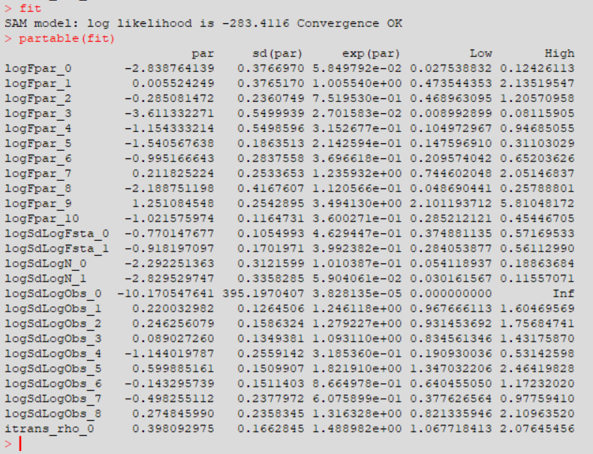
SAM run with “preferred conf”
Return a model fit, says convergence OK, but:
Observation variance for the catches very low and CV very high
Not a valid run

Slide 9
Fixed process error variance (0.2)
Model converges properly and all residuals are well estimated
Residuals “OK” except for GSA17W age 3 and 4 ➔ decoupling Q necessary

Slide 10
Fixed process error variance (0.2)

Slide 11
Sensitivity to assumption on PE variance

Slide 12
Conclusions
Tried many different configuration, always problems either with observation variance for the catches of F random walk variances
Making assumption on PE variance makes estimation of other parameters possible
However, PE assumption has an impact on estimated stock trajectories
Further investigations are needed :
Technical issue : find out how to run it with default initial parameters values
Coupling and decoupling parameters based on this first run
Look at retrospective analysis, leave one out run...

